Slide 1
Azure DevOps
By Phani Prasad

Slide 2
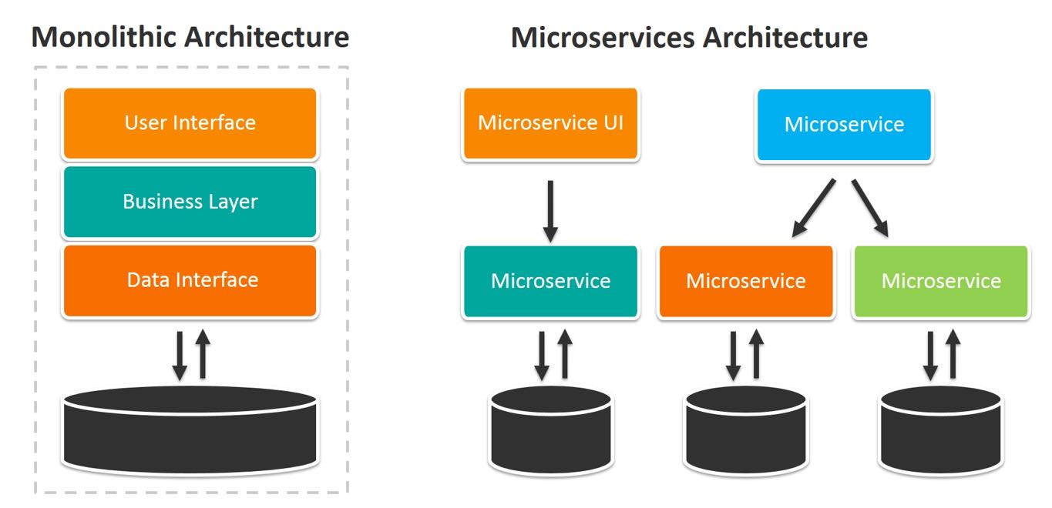

Slide 3
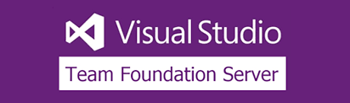

EVALUATION OF AZURE DEVOPS
On Sep 10, 2018
Microsoft renamed TFS as
To Azure DevOps Services
Azure DevOps Server is a set of collaborative software development tools, hosted on-premises.

Slide 4
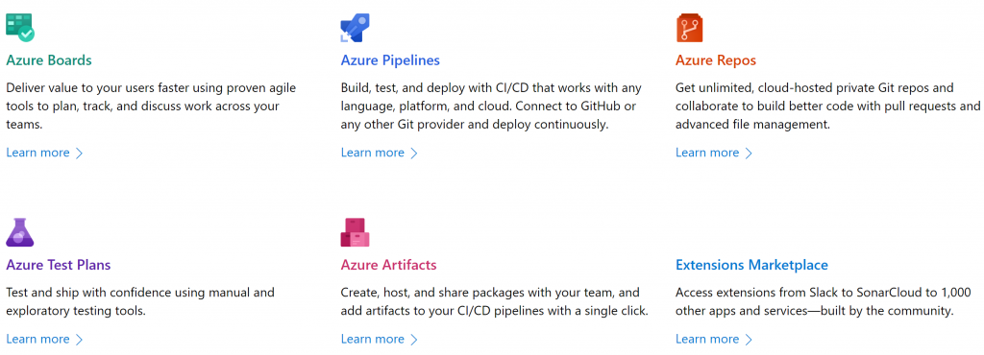
Azure Devops at a Glance

Slide 5
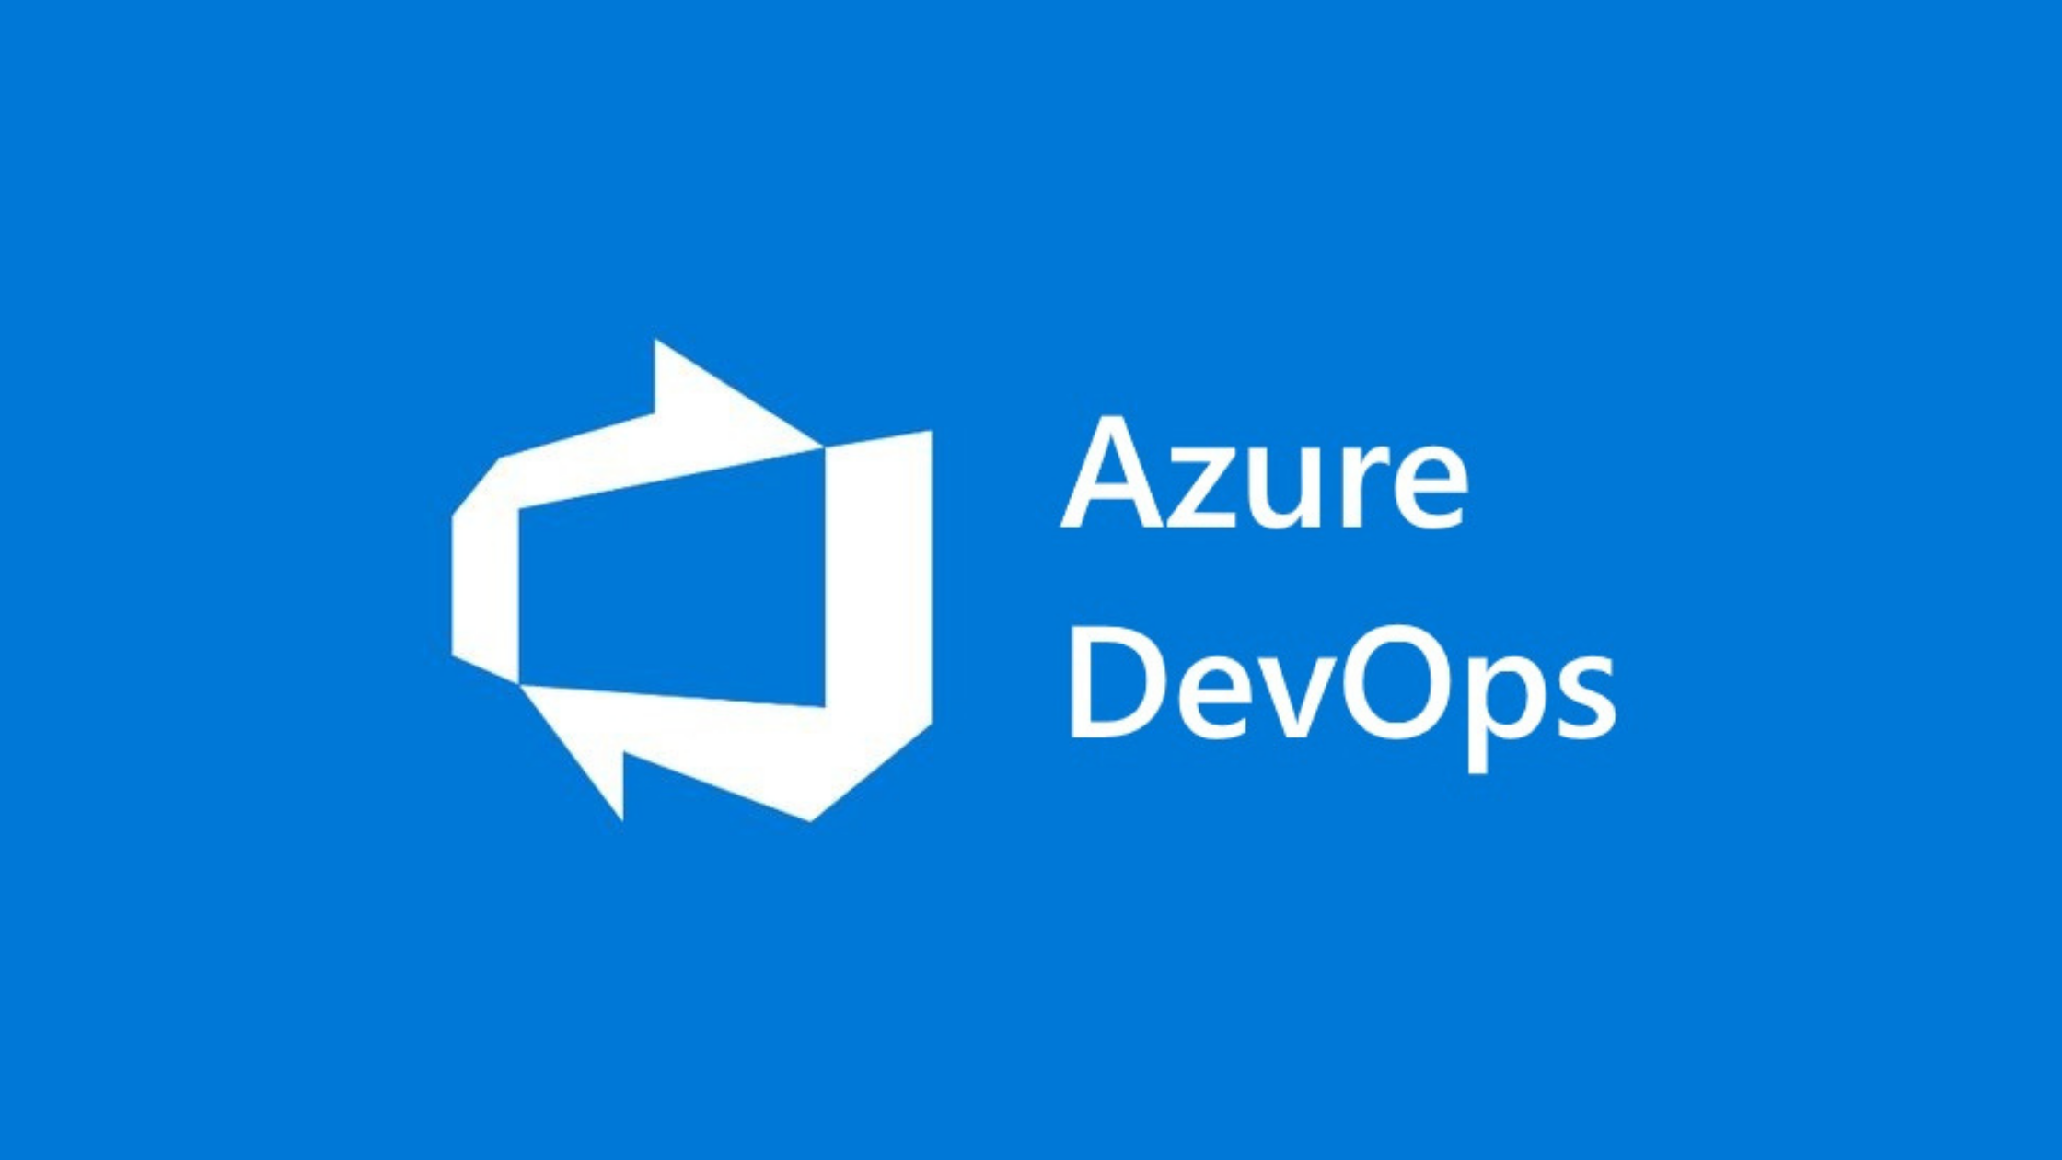
Azure Devops Contents
Azure Boards
Azure Repos
Azure Pipelines (Build and Release)
Agent Pool
Azure Artifacts
Azure Deployment groups
Azure Kubernetes service
Service Connections

Slide 6
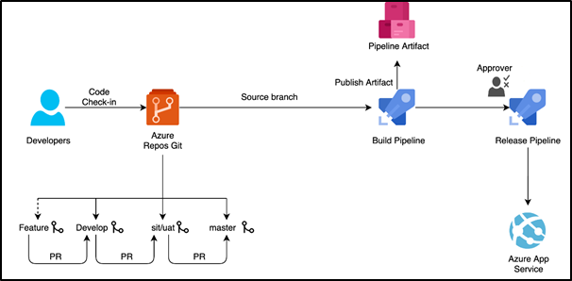
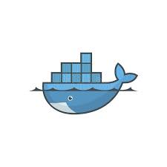
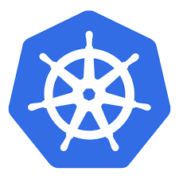
Azure DevOps Flow chart
OR
Docker image

Slide 7
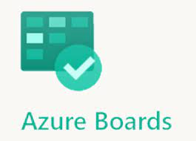
Azure boards make the work of tracking tasks, bugs, and features a lot easier.
In this, there are three types of work items:
Epic work item which tracks features or any requirements,
Issue work item which tracks bugs or any
small changes and task work item which tracks works that are smaller than that of tracked by issue.

Slide 8
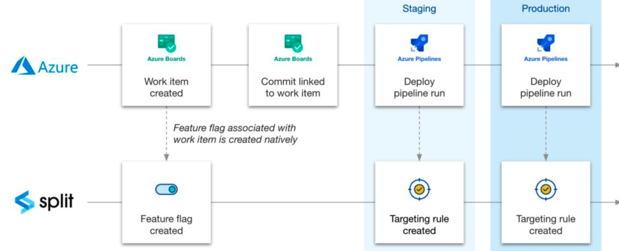

Slide 9
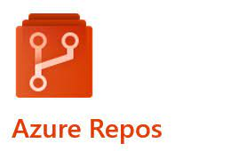


Azure DevOps Repo or Repos is a collection of many version control tools that could be used to manage your code.
It provides mainly two types of version control software:
GIT repo and TFVC (Team foundation version control).
We can integrate GIT, SUB VERSION and BIT-BUCKET as SCM

Slide 10
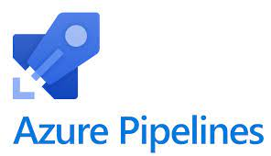
The Azure DevOps pipeline can be used in creating and testing your code automatically and also in giving access to other users. As it is a combination of Continuous Integration and continuous delivery, it can produce consistent and good quality code with using both of them. For public projects, Azure pipelines are completely free while for private projects, you can get 30 hours of it free for every month. You might be wondering what azure pipelines are, we saved it for a later discussion.

Slide 11
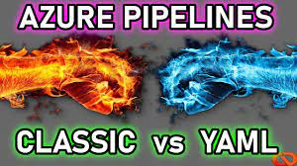

Slide 12
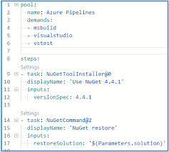
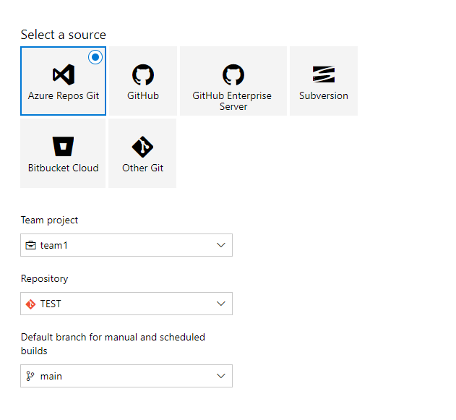
YAML PIPELINE
CLASSIC PIPELINE

Slide 13
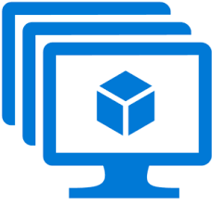
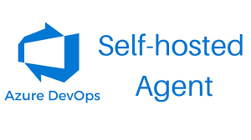
Azure Agent Pools
Azure Microsoft Agent
An agent pool is a collection of agents. Instead of managing each agent individually, you organize agents into agent pools.
When you configure an agent, it is registered with a single pool, and when you create a pipeline, you specify the pool in which the pipeline runs.
When you run the pipeline, it runs on an agent from that pool that meets the demands of the pipeline.

Slide 14
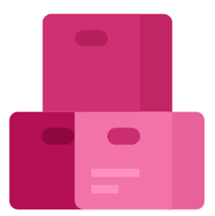
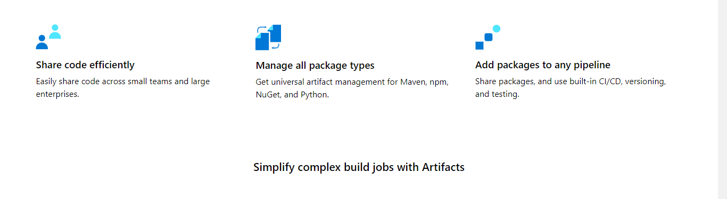
Azure Artifacts

Slide 15
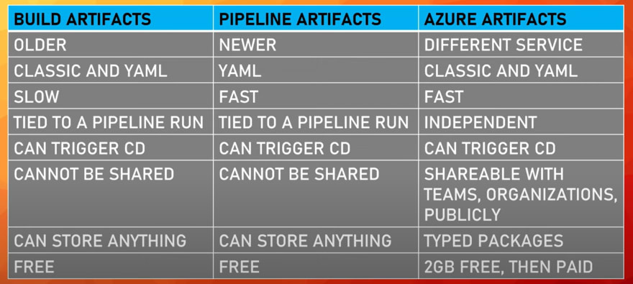

Slide 16
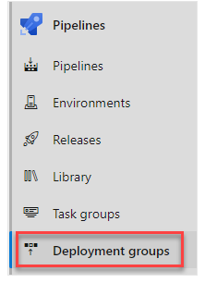

DEPLOYMENT GROUPS
A deployment group is a set of virtual machines with deployment agents.
Every VM of the deployment group interacts with Azure Pipelines to coordinate the deployment tasks.
Where we can use ?
Deployment groups represent the physical environments;
for example, "Dev", "Test", or "Production" environment.
In effect, a deployment group is just another grouping of agents, much like an agent pool.
Deployment groups are only available with Classic release pipelines and are different from deployment jobs

Slide 17

A service connection, in simple terms, is a defined connection that allows Azure DevOps to communicate with an external service.
SERVICE CONNECTIONS
We can deploy artifacts or docker images of another azure account by validating using azure service connections
Build and scale with managed Kubernetes.

Slide 18
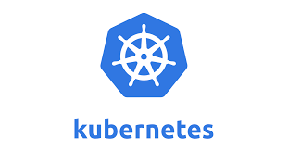
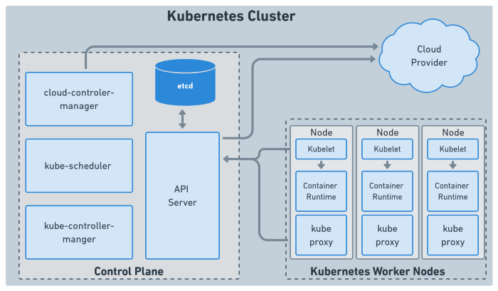

Slide 19
> API server - Entry point for a user to communicate cluster > Scheduler - Decides on which node new pod should be scheduled (It gets request from Kubelet processor) > Controller Manager - Checks the status of pods like crashing etc., It sends request to scheduler to like restart which worker node and restart pods
KUBERNETES COMPONENTS

